Slide 1
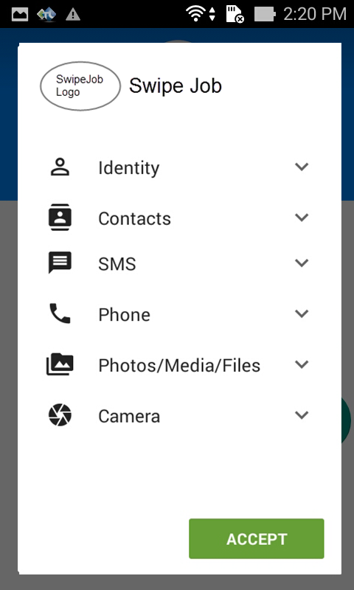
1. Install JobPortal App
1.1.1. Overview and Goal
This screen is displayed to confirm permission to access phone/contact/SMS/Camera… if user wants to install the app
1.1.2. Resolution:
User Storyboard:
When a jobseeker downloads the app file “JobPortal.apk” and start to install, the app displays access permission confirmation as screenshot.
Click Accept to install
This screen only displayed if we upload the app to GooglePlay / AppStore
For test environment it is NOT displayed

Slide 2
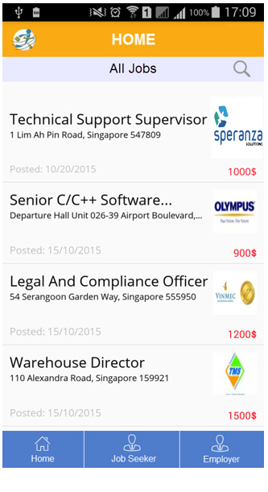
1.1 Job Portal Mobile Overview
1.1.1. Overview and Goal
This Mobile App (Android & IOS) is used for JobSeeker / Employer who wants to find/post a job.
JobSeeker & Employer need to log-in before using the app.
1.1.2. Resolution:
User Storyboard:
JobSeeker login to the app to search/ swipe a desired jobs.
JobSeeker can also view saved jobs, applied jobs, update profile.
Employer login to the app to post a job, or accept/reject an applicant.
Employer can also view saved jobs, posted jobs, update profile
This screen for all users ( guest users - not logged in)

Slide 3
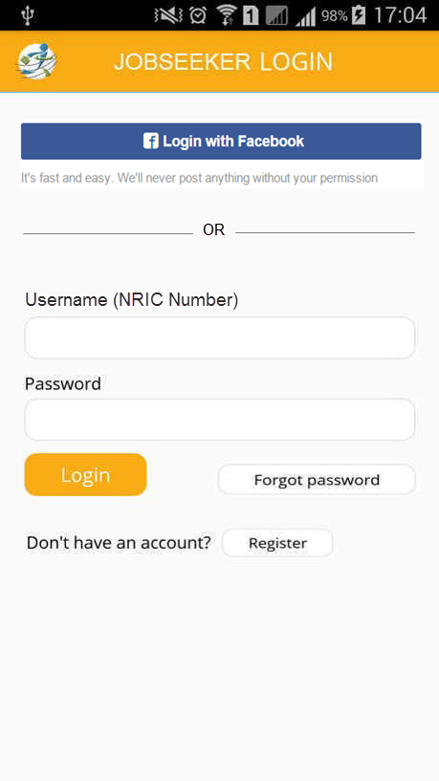
1.2. Login screen(JobSeeker)
1.1.1. Overview and Goal
• When selecting “Job Seeker” option from Home menu, the Login screen is displayed to require login or register an account.
• Fields: Email(username), Password
• Buttons: Login, Forgot password, Register
1.1.2. Resolution:
User Storyboard:
Touch Login, system will check account is valid or not
Touch “Forgot password” will show next screen to enter username(email) to be received an email for changing password
Touch Register if user does not have an account.
User can also Login with Facebook that already signed up before

Slide 4
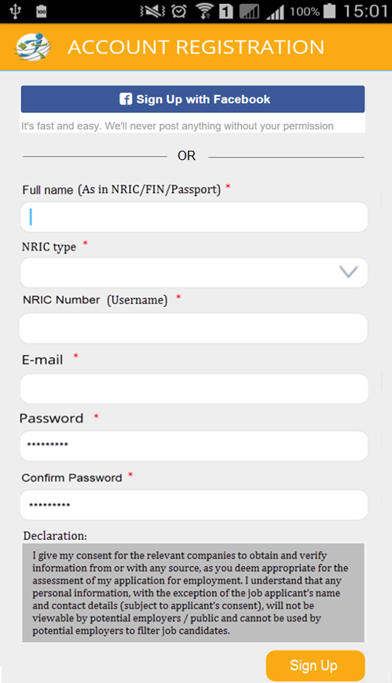
1.3. Register screen for JobSeeker
1.1.1. Overview and Goal
• Register screen: when guest selects option “Register” from Login screen, Register screen is displayed
• Fields: all fields should be as the design
• Buttons: Sign Up
1.1.2. Resolution:
User Storyboard:
Guest enters account information and touch Sign Up to register an account.
After submitting successfully, go to the registered email and touch on an activation link to active account
When account is active, Jobseeker can login to the app

Slide 5
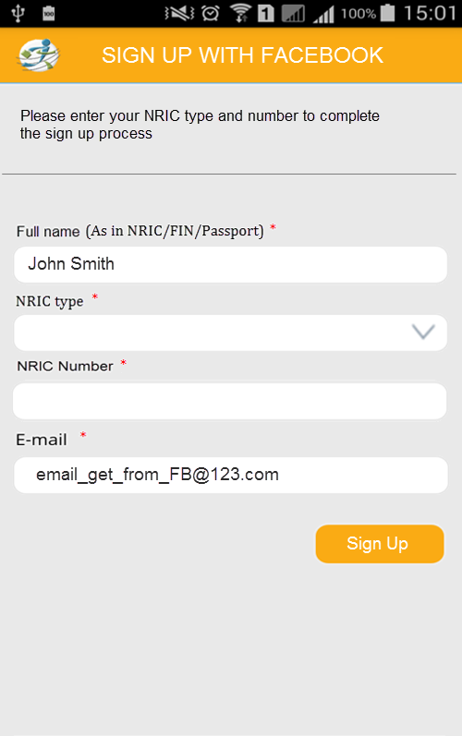
1.3.1. Sign up with Facebook
1.1.1. Overview and Goal
• After Jobseeker logged in the FB successfully, this screen will be displayed to enter NRIC type/number
• Fields: all fields should be as the design
• Buttons: Sign Up
1.1.2. Resolution:
User Storyboard:
Full name and Email will get from FB
Jobseeker needs to provide NRIC number/type
Then click Sign Up to complete and access the app

Slide 6
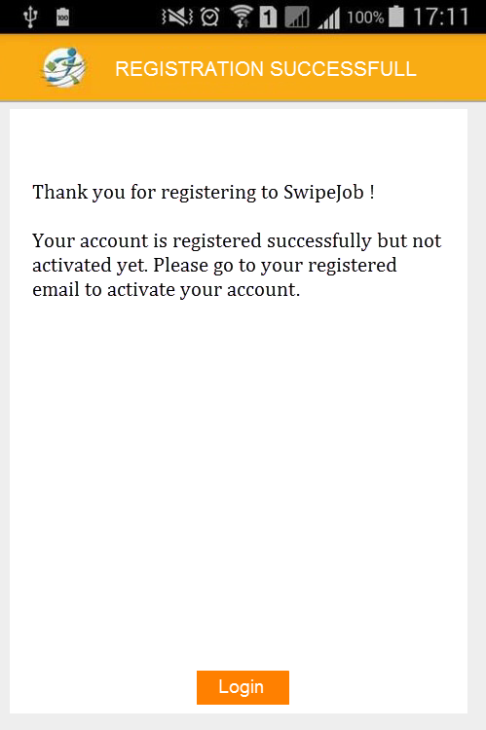
1.4. Register Successfully screen
1.1.1. Overview and Goal
• This screen will be displayed when jobseeker completed registration
1.1.2. Resolution:
User Storyboard:
Then Jobseeker need to go registered email to activate the account
When account is active, Jobseeker can login to the app
Please note that: If jobseeker sign up by Facebook then this screen will NOT be displayed, and that account is auto set to active

Slide 7
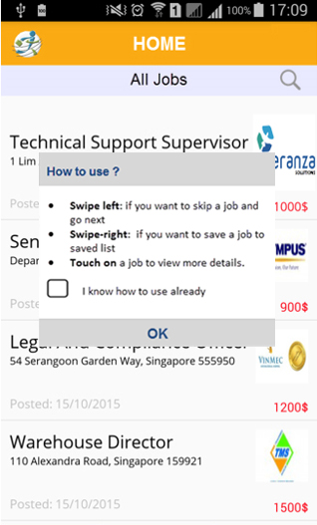
1.5. Home screen (JobSeeker)
1.1.1. Overview and Goal
• The Home screen will show ALL jobs with the search option
• Notification: JobSeeker can view messages at the right-top screen
• For the first time login, jobseeker will see a “How to use” popup; and if don’t want it to show again then select “I know how to use already” check box
1.1.2. Resolution:
User Storyboard:
Touch to call the Left menu
Swipe jobs: from the list, JobSeeker can swipe-left to skip job, swipe-right to save job
Touch on a job to view in more details
Touch on Email icon will open Messages screen

Slide 8
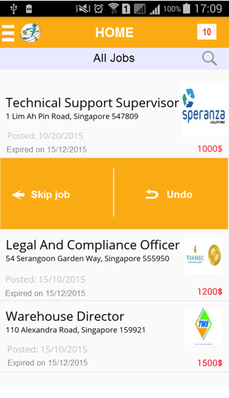
1.5.1. Swipe Left With Undo Action
1.1.1. Overview and Goal
• When Jobseeker swipe left to skip/delete a job, the system show 2 options to confirm jobseeker to skip/delete job or Undo the action
1.1.2. Resolution:
User Storyboard:
Touch “Skip job” to skip that job and below job will be pushed up
Touch on Undo if want to undo the action

Slide 9
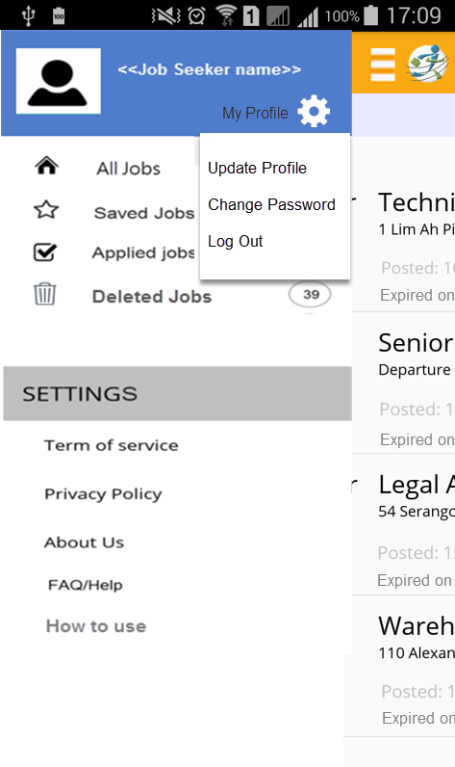


1.6. Left Menu (JobSeeker)
1.1.1. Overview and Goal
• The Left menu will be displayed when Jobseeker touch on menu icon or swipe right
1.1.2. Resolution:
User Storyboard:
Touch “All Jobs” to show all jobs
Touch “Saved Jobs” to view all saved jobs
Touch on “Applied Jobs” to view all applied jobs
Touch Deleted Jobs to view/restore deleted jobs
Touch on any options from Settings to view info
When jobseeker touch on will open a popup with options “Update Profile”, “Change Password” & “Logout”

Slide 10
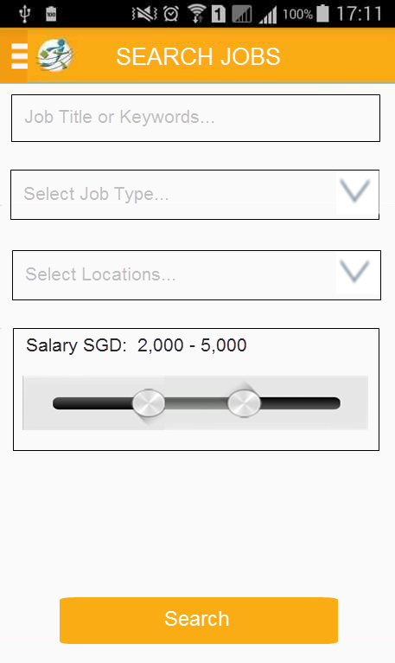
1.7. Search Criteria (JobSeeker)
1.1.1. Overview and Goal
• When Jobseeker touch “Search Jobs” option from left menu, the Search screen displays as design
1.1.2. Resolution:
User Storyboard:
Enter a job title or keywords
Select job types
Select locations
Select salary ranges
Touch “Search” button
We have 3 job types for Jobseeker to search:
1. Full-Time/Contract
2. Part-Time/Temporary/Project Basis
3. Internship

Slide 11
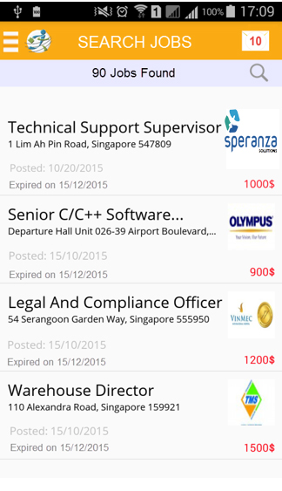

1.8. Search Jobs Result (JobSeeker)
1.1.1. Overview and Goal
• When touching Search button, the search result screen displays as screenshot
1.1.2. Resolution:
User Storyboard:
Swipe left: if want to skip job
Swipe-right: if want to save that job
Touch on a job to view more details.
Touch “Search Icon” again to edit the search criteria
Touch to call Left menu

Slide 12
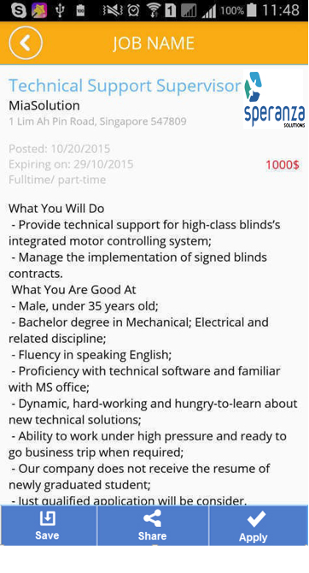
1.9. Job Details screen (JobSeeker)
1.1.1. Overview and Goal
• In every screen when Jobseeker touch on a job then system opens it in more details screen
•The fields and info should be displayed as design
1.1.2. Resolution:
User Storyboard:
Touch Back to return the previous screen
Touch Save Job to save that job
Touch Apply Job to apply that job
Touch Share Job to share that job through social media

Slide 13
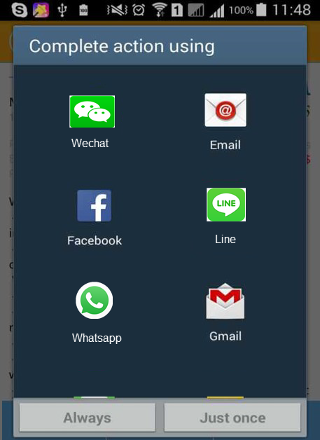
1.10. Share Job screen (JobSeeker)
1.1.1. Overview and Goal
• Share job through social media / communication platforms
1.1.2. Resolution:
User Storyboard:
When JobSeeker touch Share Job from Details screen, the Social media selection screen will be displayed (getting all from the device)

Slide 14
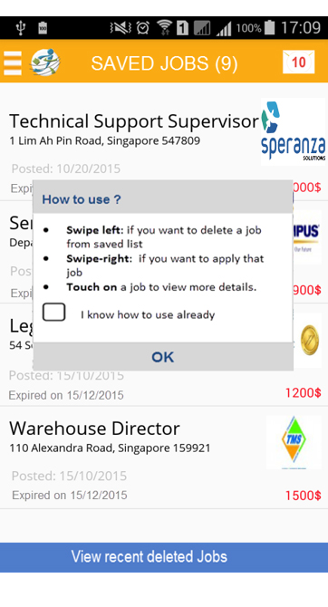
1.11. Saved Jobs screen (JobSeeker)
1.1.1. Overview and Goal
• This screen will be displayed when JobSeeker touch on “Saved Jobs” from left menu. The screen shows all saved jobs.
• For the first time login, jobseeker will see a “How to use” popup; and if don’t want it to show again then select “I know how to use already” check box
1.1.2. Resolution:
User Storyboard:
Swipe left: if want to delete a job from saved list (Jobseeker can review recent deleted jobs by touching on “View recent deleted jobs” button
Swipe-right: if want to apply that job
Touch on a job to view more details.
Touch Menu icon to call Left menu

Slide 15
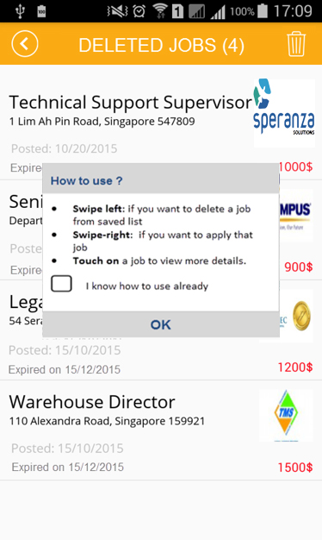

1.12. Recent Deleted Jobs screen
1.1.1. Overview and Goal
• This screen will be displayed when JobSeeker touch on “View recent deleted jobs” from “Saved Jobs” screen.
• For the first time login, jobseeker will see a “How to use” popup; and if don’t want it to show again then select “I know how to use already” check box
1.1.2. Resolution:
User Storyboard:
Swipe left: if want to remove a job from deleted list
Swipe-right: if want to restore that job to saved list.
Touch on a job to view more details.
Touch “Back” button to return “Saved Jobs” screen
Touch DELETE icon to clear all deleted jobs (with confirm message “Are you sure you want to clear all deleted jobs? - Yes/No)

Slide 16
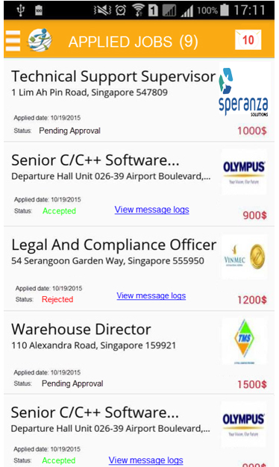
1.13. Applied Jobs screen (JobSeeker)
1.1.1. Overview and Goal
• This screen will be displayed when touching on “Applied Jobs” option from Left menu. The screen shows status of all applied jobs
• All job statuses in this screen are “Pending Approval”, “Accepted”, “Rejected”
1.1.2. Resolution:
User Storyboard:
JobSeeker access to “Applied Jobs” to view status of job (Pending Approval , Accepted or Rejected)
Touch on a job to view more details
For Accepted & Rejected, Jobseeker can touch “View message logs” to view all messages chatted with the employer for that job

Slide 17
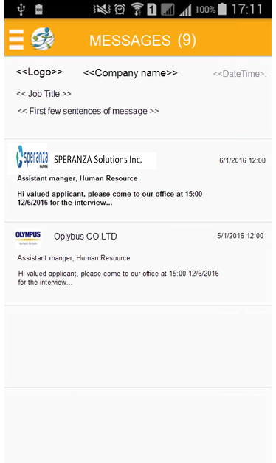

1.14. Jobs Messages screen(JobSeeker)
1.1.1. Overview and Goal
• From Home page JobSeeker touch on to open Message screen (as the screenshot)
1.1.2. Resolution:
User Storyboard:
On Message screen, JobSeeker can touch on a message to view in details (as next slide)
For un-read messages will be in BOLD format

Slide 18
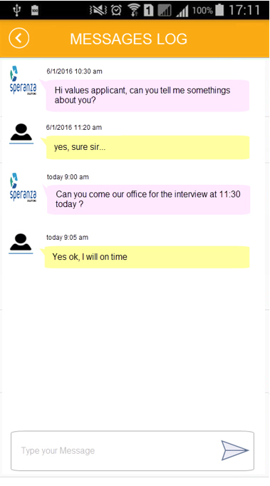
1.15. Message Logs screen(JobSeeker)
1.1.1. Overview and Goal
• The Message Details screen will be displayed when JobSeeker touch on a message from the previous screen (Message list screen)
1.1.2. Resolution:
User Storyboard:
On this screen, JobSeeker can see history of messages for that job of an employer
Job seeker can also type new message

Slide 19
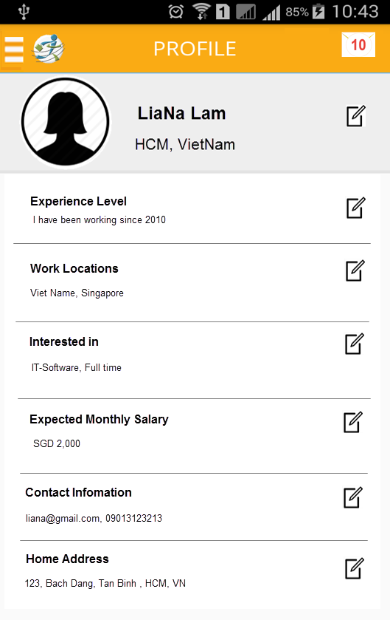
1.16. Profile screen (JobSeeker)
1.1.1. Overview and Goal
• This screen will be displayed when Jobseeker touch on “My Profile” from Left menu
1.1.2. Resolution:
User Storyboard:
JobSeeker can update info by touching
Or add new info by touching
When touching, a new screen will be displayed – please go next slide to see an example. For all other Edit sections should similar to that

Slide 20
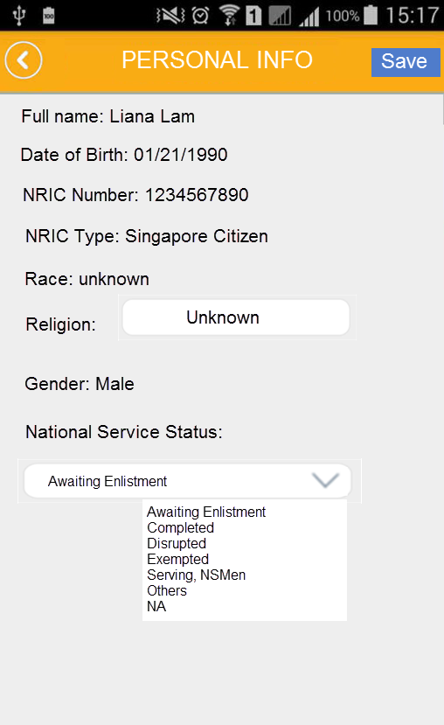
1.17. Edit Personal Info (JobSeeker)
1.1.1. Overview and Goal
• This screen will be displayed when Jobseeker touch on Edit icon at Personal section in Profile screen
1.1.2. Resolution:
User Storyboard:
For “fullname”, “DOB”, “Race”, “Gender”, “NRIC” can NOT be modified
- JobSeeker can update info by touching Save; or touch Back button to return Profile screen without saving

Slide 21
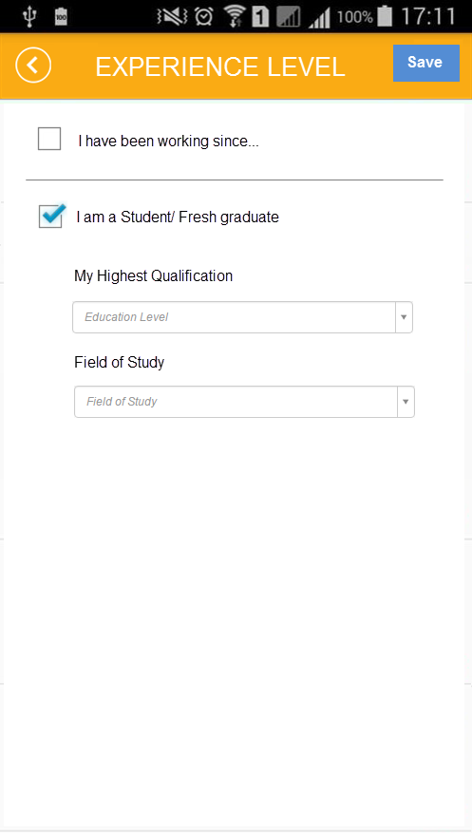
1.17.1. Edit Experience Level(JobSeeker)
1.1.1. Overview and Goal
• This screen will be displayed when Jobseeker touch on Edit icon at Experience Level in Profile screen
1.1.2. Resolution:
User Storyboard:
If select “I have experience.. “, then the Year box will be displayed below the check box
IF select “I am Student..”, then the 2 fields “Highest Qualification” and “Field Study” displayed

Slide 22
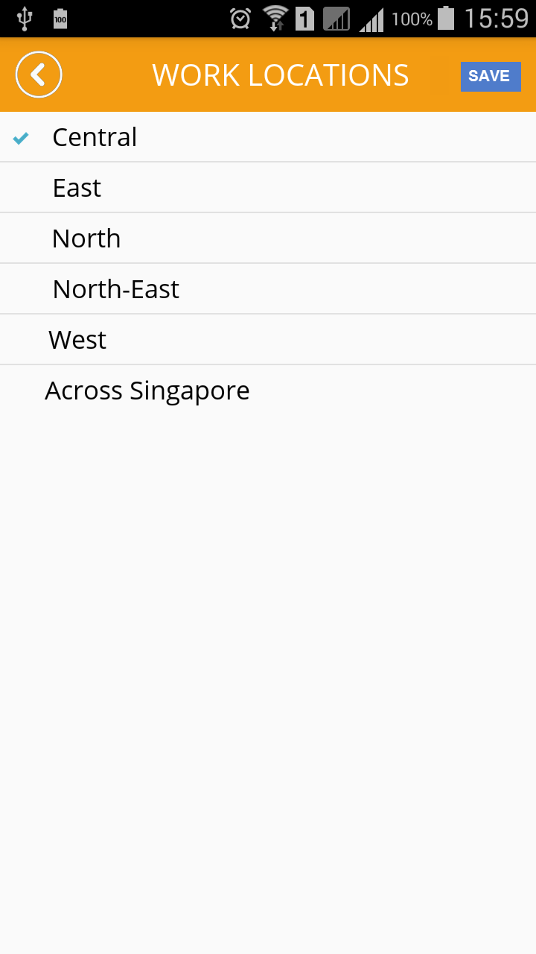
1.17.2. Edit Locations (JobSeeker)
1.1.1. Overview and Goal
• This screen will be displayed when Jobseeker touch on Edit icon at Location section in Profile screen
1.1.2. Resolution:
User Storyboard:
Touch on an option in this screen will show sub-locations as next slide

Slide 23
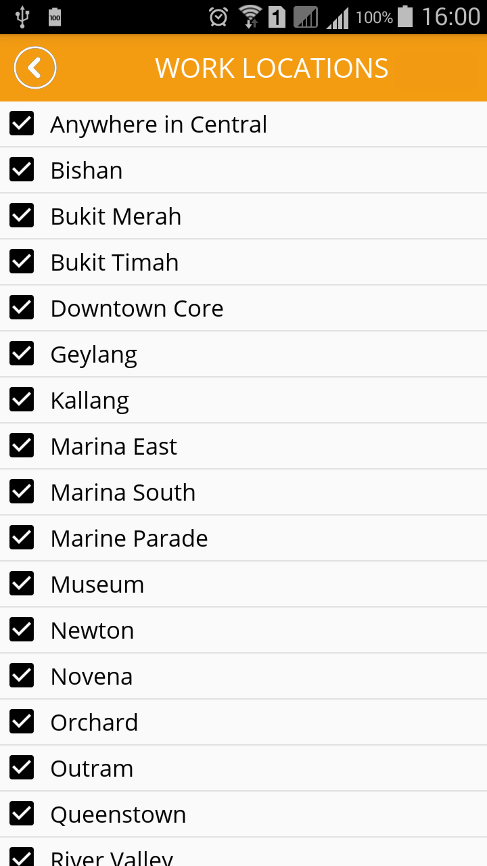
1.17.3. Edit Locations cont…
1.1.1. Overview and Goal
• This screen will be displayed when Jobseeker touch on “Central” in previous screen
1.1.2. Resolution:
User Storyboard:
Touch on “Anywhere in Central” to select all, then touch Back to return previous screen and touch Save to update selected location

Slide 24
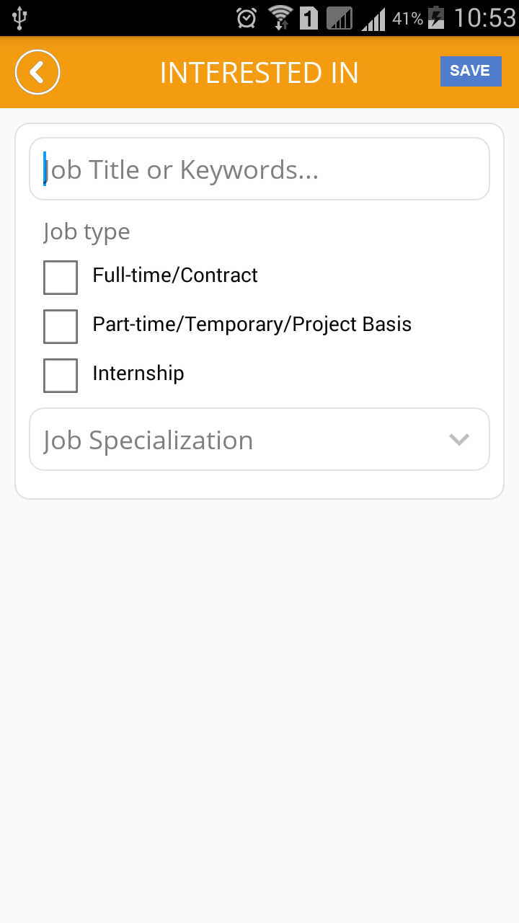
1.17.4. Edit Interested in (JobSeeker)
1.1.1. Overview and Goal
• This screen will be displayed when Jobseeker touch on Edit icon at Interested In section in Profile screen
1.1.2. Resolution:
User Storyboard:
Touch on “Specialization” option to open the Specialization selection screen – as next slide

Slide 25
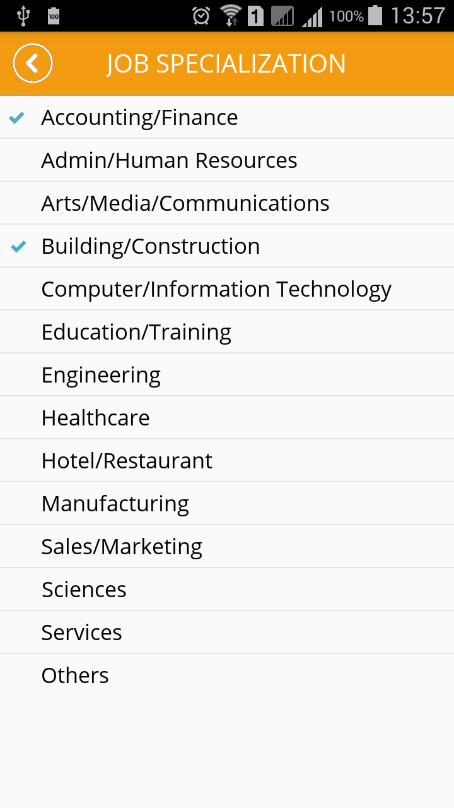
1.17.5. Specialization (JobSeeker)
1.1.1. Overview and Goal
• This screen will be displayed when Jobseeker touch on Specialization from previous screen
1.1.2. Resolution:
User Storyboard:
Touch on an option to open sub screen - as next slide

Slide 26
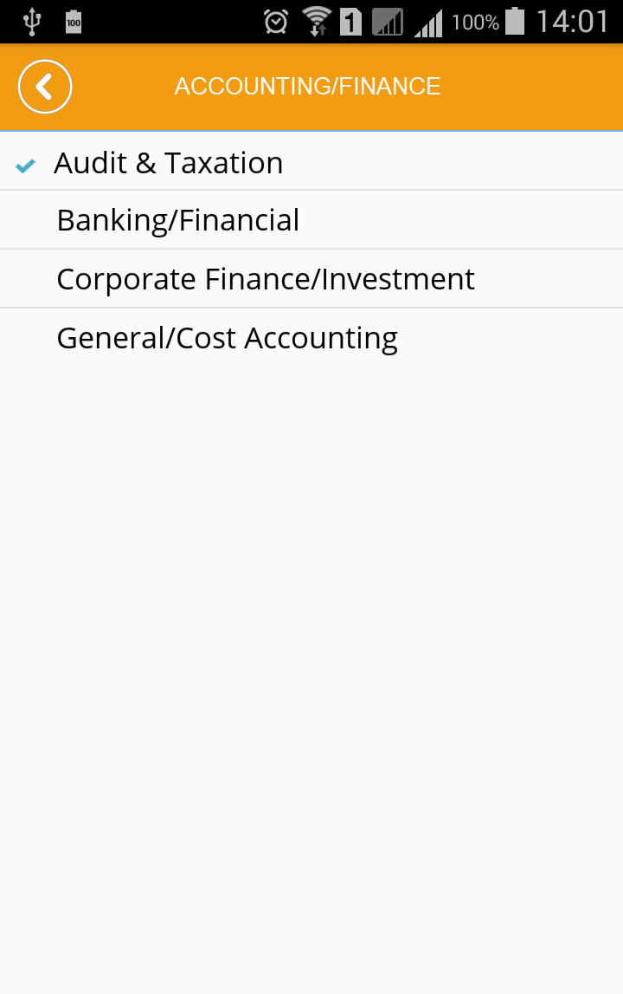
1.17.6. Specialization cont…
1.1.1. Overview and Goal
• This screen will be displayed when Jobseeker touch on a Specialization from previous screen (ex, “Accounting/Finance”)
1.1.2. Resolution:
User Storyboard:
Touch on an option (ex, “Audit & Taxation” ) to open next screen

Slide 27
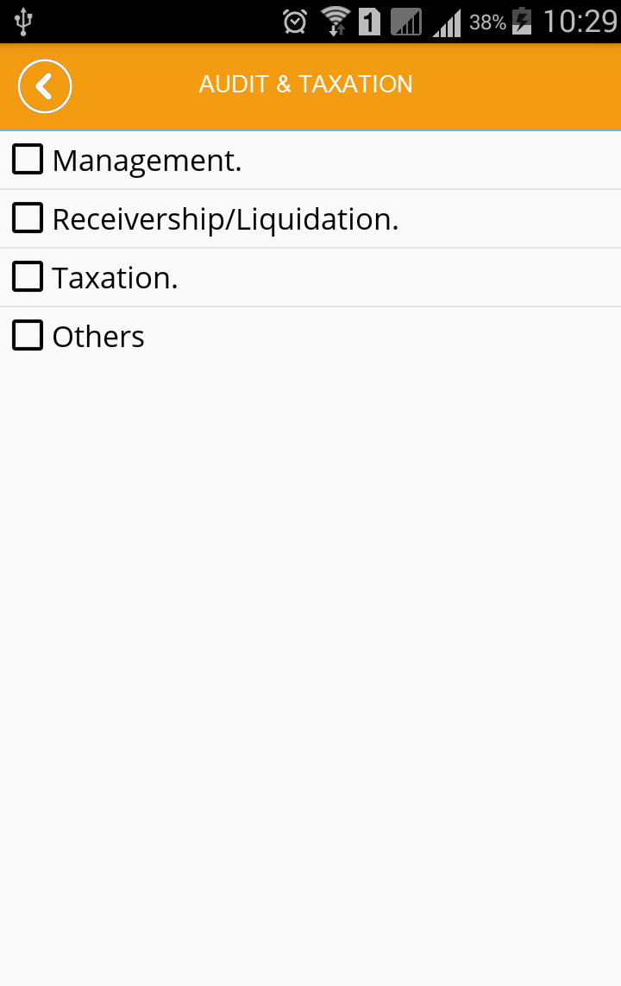
1.17.7. Specialization cont…
1.1.1. Overview and Goal
• This screen will be displayed when Jobseeker touch on “Audit & Taxation” from previous screen
1.1.2. Resolution:
User Storyboard:
Select options and touch Back to return previous screen

Slide 28
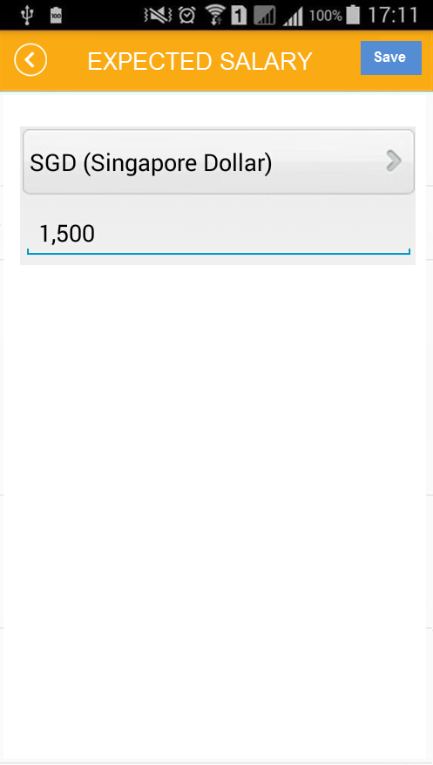
1.17.8. Edit Expected Salary(JobSeeker)
1.1.1. Overview and Goal
• This screen will be displayed when Jobseeker touch on Edit icon at Expected Salary in Profile screen
1.1.2. Resolution:
User Storyboard:
Please help to confirm that we ONLY use SGD or any other currency ?

Slide 29
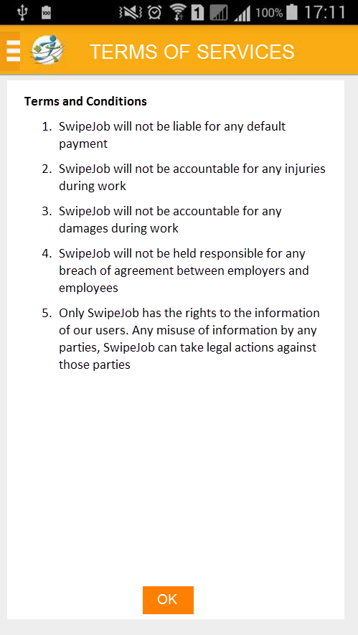
1.18. Terms of Services (JobSeeker)
1.1.1. Overview and Goal
• This screen will be displayed when JobSeeker touch on “Terms of Service” from the Left menu
1.1.2. Resolution:
User Storyboard:
Similar this screen for Privacy Policy/ About Us/ Help

Slide 30
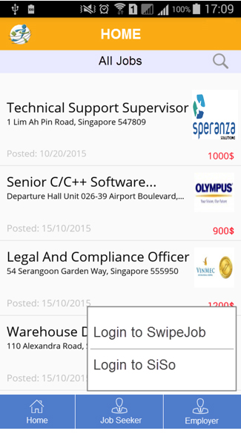
1.18.1 For Employer
1.1.1. Overview and Goal
When employer touch on “Employer” option, the system shows 2 options to login
Login to SwipeJob
Login to SiSo
1.1.2. Resolution:
User Storyboard:
Touch “Login to SwipeJob” to go the SwipeJob login page
For “Login to SiSo” function will be implement in phase 2

Slide 31
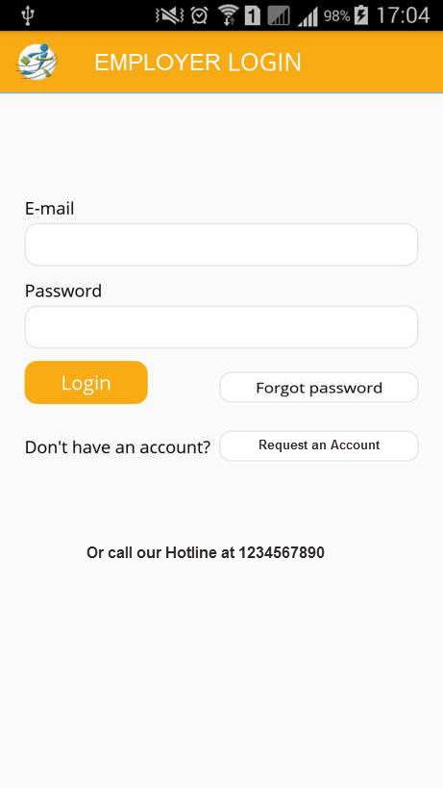
1.19. Login screen (Employer)
1.1.1. Overview and Goal
• When selecting “Employer” option from Home menu, the Login screen is displayed to require login or register an account.
• Fields: Email(username), Password
• Buttons: Login, Forgot password, Request an Account
1.1.2. Resolution:
User Storyboard:
Touch Login, system will check account is valid or not
Touch “Forgot password” will show next screen to enter username(email) to be received an email for changing password
Touch Request an Account if user does not have an account.

Slide 32
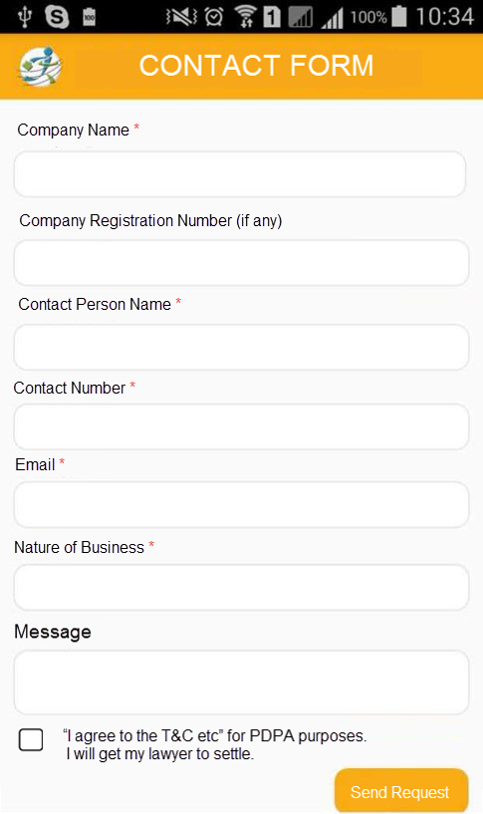
1.20. Contact Screen for Employer
1.1.1. Overview and Goal
• Contact screen: employer touch “Request for an Account” from Login screen, Contact screen will be displayed.
• Fields: all fields should be as the design
• Buttons: Send Request
1.1.2. Resolution:
User Storyboard:
Employer enters company name, contact name…etc.. and touch Send Request to submit the form.
After submitting successfully, SwipeJob will contact him
When account is active, Employer can login to the app

Slide 33
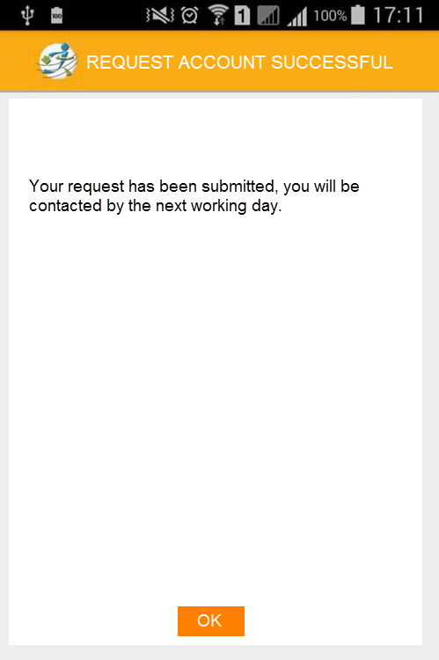
1.21. Request Account Successful
1.1.1. Overview and Goal
• Once sent, have a notification saying “Your request has been submitted, you will be contacted by the next working day”.
1.1.2. Resolution:
User Storyboard:

Slide 34
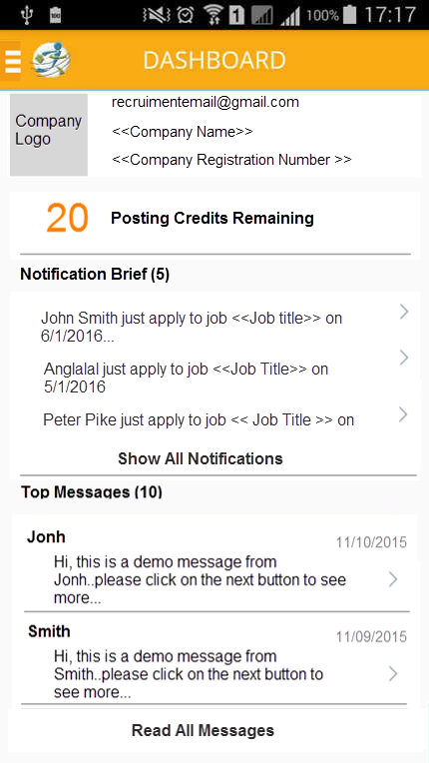
1.22. Dashboard screen (Employer)
1.1.1. Overview and Goal
• This screen will be displayed when Employer login to the app
• Layout: the layout should be looked as design.
For Notification/Posting Credit will be implement in phase 2
1.1.2. Resolution:
User Storyboard:
Individual Listing: when touched will show Individual listings screen
Accepted Applicants: when touched will show the all Accepted Applicants screen
Active Job Listings: when touched will open all Active Jobs screen
Read All Message: when touched will show Message board screen
Touch to call the Left menu

Slide 35
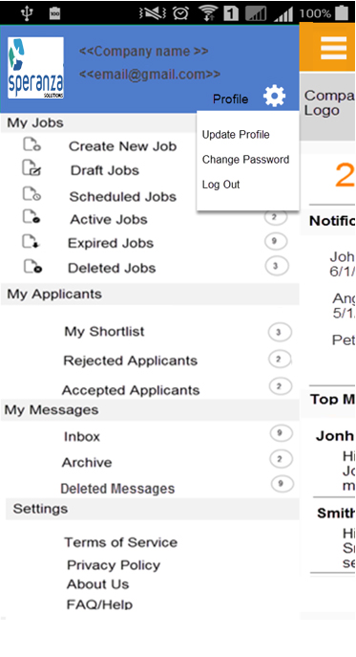

1.23. Left menu (Employer)
1.1.1. Overview and Goal
• This screen will be displayed when Employer touch on menu icon
• Layout: the layout should be looked as design.
1.1.2. Resolution:
User Storyboard:
- When Employer touch on will open a popup with options “Update Profile”, “Change Password” & “Logout”
We NO need “All Applicants” option in “My Applicants” tab because applicants only displayed when employer view an active job
So we now removed it from the tab

Slide 36
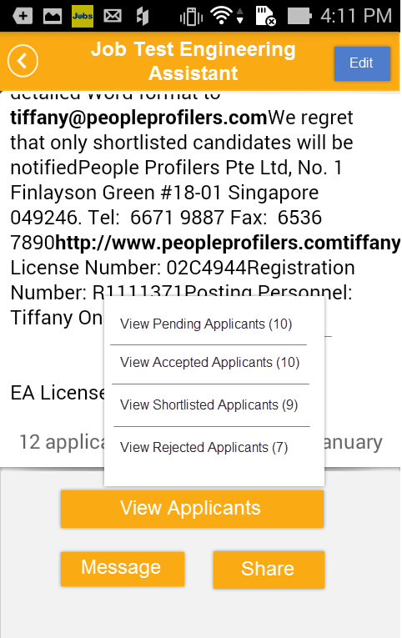
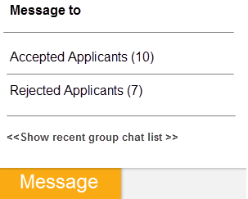
1.23.1 Individual Listing for an Active Job
1.1.1. Overview and Goal
• This screen will be displayed when employer touch on an active job to view in details
• Buttons as screenshot
1.1.2. Resolution:
User Storyboard:
Touch Edit to navigate to Edit job screen
Touch “View Applicants” to open popup as screenshot
Touch “Message” will popup options menu as below
The Share function will be in phase 2

Slide 37
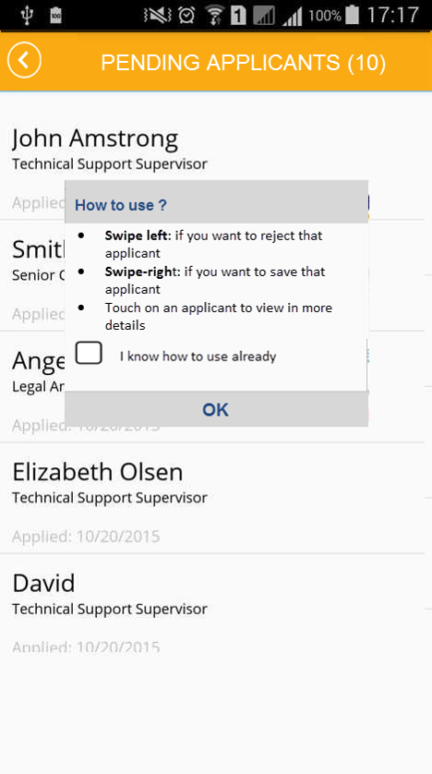
1.24. Pending Applicants for a Job
1.1.1. Overview and Goal
• This screen will be displayed when employer touch on “View Applicants” -> “Pending Applicants” from the previous screen 1.23.1.
• Employer can reject or save applicant to shortlist
• The popup “How to use” will popup on the first login
1.1.2. Resolution:
User Storyboard:
Swipe left: to reject that applicant
Swipe-right: to save that applicant
Touch on an applicant to view in more details

Slide 38
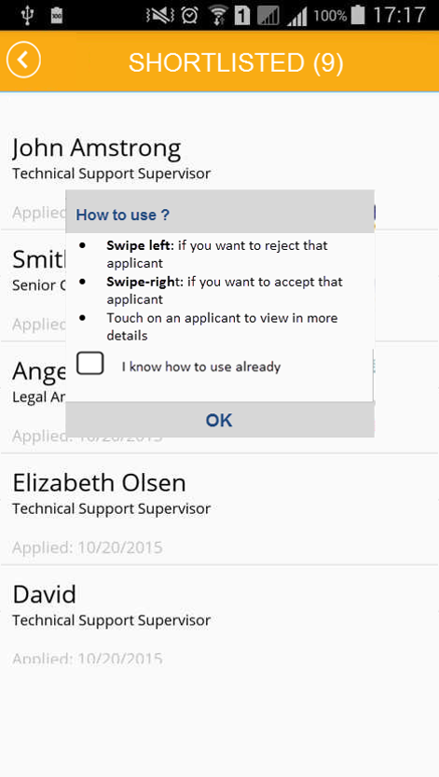
1.25. Shortlisted Applicants for a Job
1.1.1. Overview and Goal
• This screen will be displayed when employer touch on “View Applicants” -> “Shortlisted Applicants” from the previous screen 1.23.1.
• Employer can reject or accept applicant
• The popup “How to use” will popup on the first login
1.1.2. Resolution:
User Storyboard:
Swipe left: to reject that applicant
Swipe-right: to accept that applicant
Touch on an applicant to view in more details

Slide 39
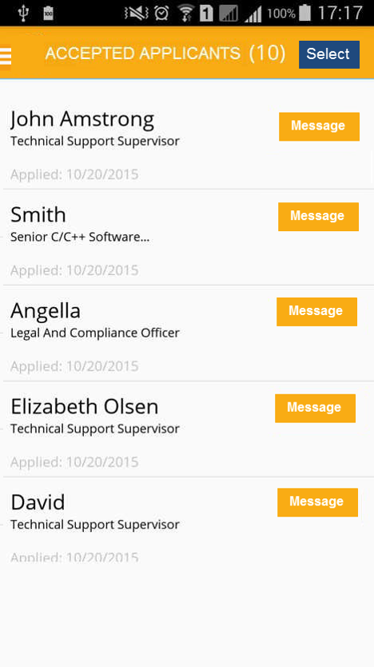
1.26. Accepted Applicants for a Job
1.1.1. Overview and Goal
• This screen will be displayed when employer touch on “View Applicants” -> “Accepted Applicants” from the previous screen 1.23.1.
• In this screen employer can send a message to applicant or a group of applicants
1.1.2. Resolution:
User Storyboard:
Touch on “Message” to send a message to an applicant (you can also view message logs in Message screen – please see next slide)
Touch on Select button to select multi- applicants to chat (when touching , it changes to “Chat” button)

Slide 40

1.27. Message Logs (Employer)
1.1.1. Overview and Goal
• This screen will be displayed when employer touch on “Message” button to chat 1 to 1 Jobseeker
1.1.2. Resolution:
User Storyboard:
Enter new message and touch Chat icon

Slide 41
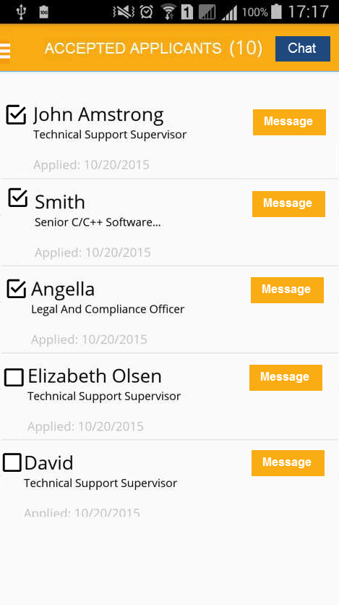
1.28. Select Multi-Chat (Employer)
1.1.1. Overview and Goal
• This screen will be displayed when employer touch on “Select” button from previous screen (after selecting, the button “Select” changed to “Chat” button)
• In this screen employer can send a message to a group of applicants
1.1.2. Resolution:
User Storyboard:
Select some applicants and touch “Chat” button, a Chat screen will be displayed as next slide

Slide 42
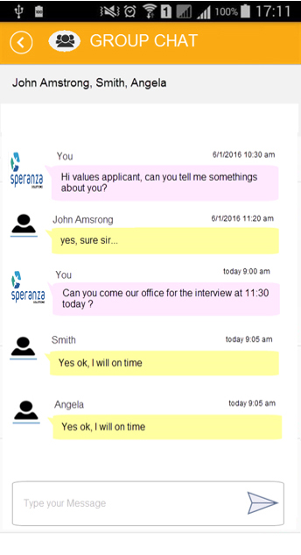
1.29. Chat to Group (Employer)
1.1.1. Overview and Goal
• This screen will be displayed when employer touch on “Chat” button for a selected group from previous screen
1.1.2. Resolution:
User Storyboard:
Question: For Group Chat, can each jobseeker see messages from other jobseekers in the group ? OR a jobseeker can only see his message and messages sent from Employer, but employer can see all ?

Slide 43
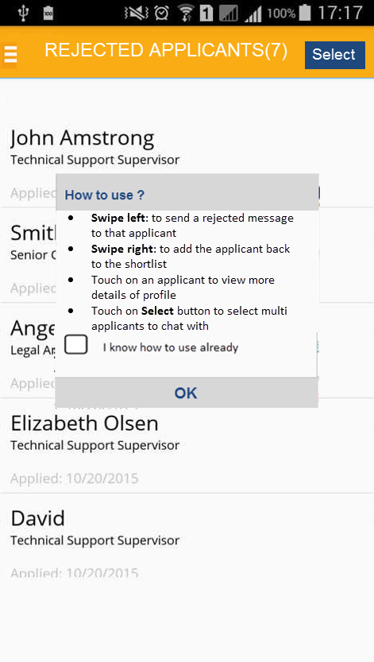
1.30. Rejected Applicants for a Job
1.1.1. Overview and Goal
• This screen will be displayed when employer touch on “View Applicants” -> “Rejected Applicants” from the previous screen 1.23.1.
• In this screen employer can also select Add applicant to short list/ or Send a reject message
1.1.2. Resolution:
User Storyboard:
Swipe left: to send an auto reject message to applicant
Swipe right: to add the applicant back to the shortlist
Touch on an applicant to view more details of profile
Touch Select button to select multi applicants to chat with (Similar to 1.28)

Slide 44
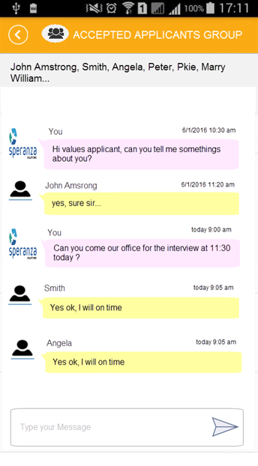
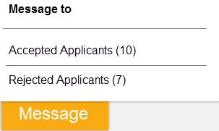
1.30.1 Accepted Applicants Chat Group
1.1.1. Overview and Goal
• This screen will be displayed when employer touch on “Message” -> “Message to Accepted Applicants” option from an active job details page
1.1.2. Resolution:
User Storyboard:

Slide 45
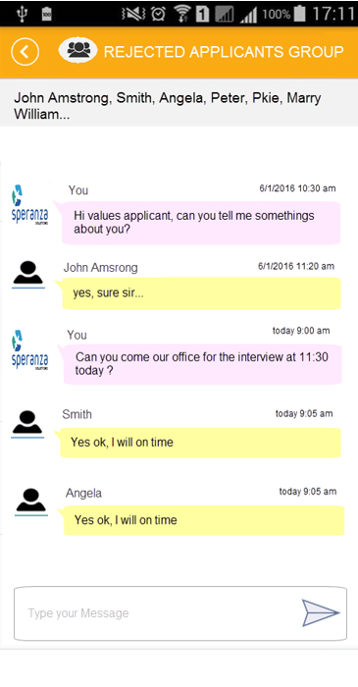
1.30.2 Rejected Applicants Chat Group
1.1.1. Overview and Goal
• This screen will be displayed when employer touch on “Message” -> “Message to Rejected Applicants” option from an active job details page
1.1.2. Resolution:
User Storyboard:

Slide 46
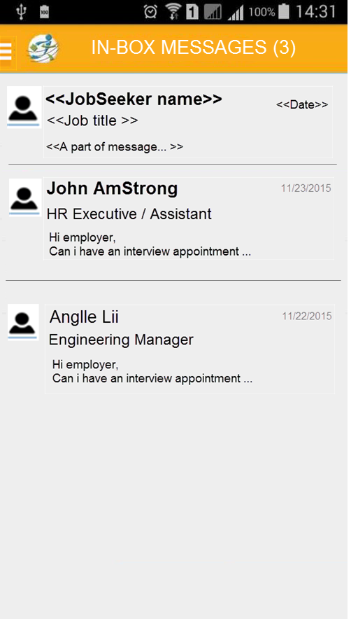
1.31. Inbox Message screen (Employer)
1.1.1. Overview and Goal
• This screen will be displayed when Employer touch on “Message/Inbox” from the Left menu
1.1.2. Resolution:
User Storyboard:
For un-read messagesm it is in BOLD format
Touch on a message to view more details with message logs (if any) – please see next slide for example

Slide 47
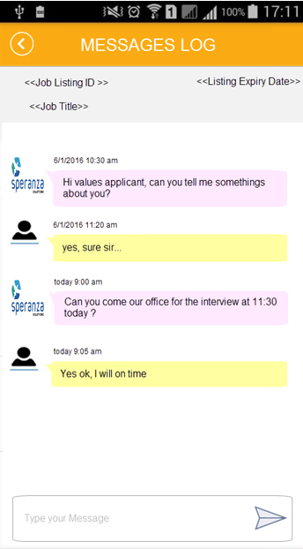
1.32. Message Details screen (Employer)
1.1.1. Overview and Goal
• This screen will be displayed when Employer touch on a message from previous screen
• In this screen employer can view new message and message logs (if any); Employer can also reply by type a new message
1.1.2. Resolution:
User Storyboard:
- Type new message to reply

Slide 48
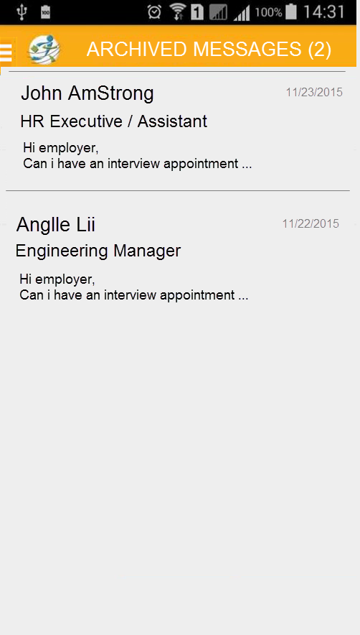
1.33. Archive Message screen (Employer)
1.1.1. Overview and Goal
• This screen will be displayed when Employer touch on “Message/Archive” from the Left menu
1.1.2. Resolution:
User Storyboard:
Touch on a message to view more details with message logs – similar to Inbox

Slide 49
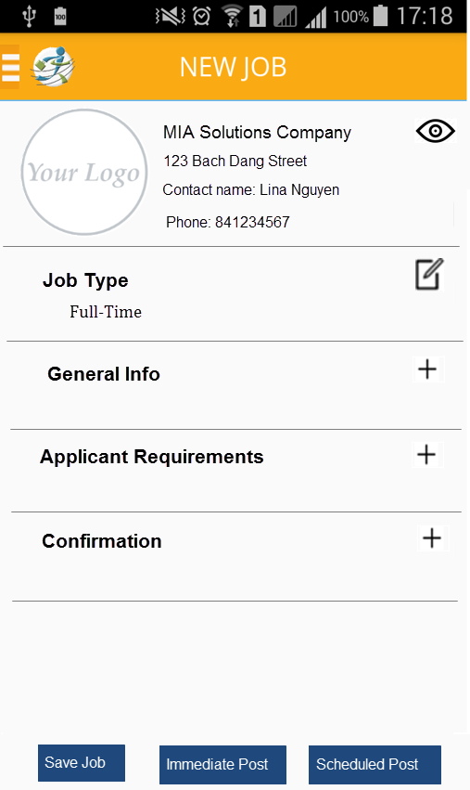
1.34. Create New Job (Employer)
1.1.1. Overview and Goal
• This screen will be displayed when Employer touch on “Create new Job” from the Left menu
• Touch to add & complete each section
1.1.2. Resolution:
User Storyboard:
For Company Info, it will auto filled once they update profile
Touch to add info for each section
For example, if you want to add info for “General Info” ,then touch on the icon and a new page will be displayed – please see next slide
This demo is for “Full time”. For “Job group” = “Part-Time/Temporary/Project Basis/Internship “ the layout is the same but some fields different based on the requirement

Slide 50

1.35. General Info page for Full Time/Contract
1.1.1. Overview and Goal
• This screen will be displayed when Employer touch to add & complete “General info”
Question:
How does “Add in job specialization 2” option work if we tick Yes/ or No?
1.1.2. Resolution:
User Storyboard:
Touch on each field to select value
For “Job Specialization” touch on
to change the selection (a new page will be displayed to select
After selection, touch “Save” button to save and return the previous screen
For other sections (Applicant Requirements, Confirmation) should be similar to this layout

Slide 51

1.35.1. General Info page for Parttime/Temporary/Project/Intership
1.1.1. Overview and Goal
• This screen will be displayed when Employer touch to add & complete “General info”
1.1.2. Resolution:
User Storyboard:
Touch on each field to select value
After selection, touch “Save” button to save and return the previous screen
For other sections (Applicant Requirements, Confirmation) should be similar to this layout

Slide 52

1.35.2. General Info page for Parttime/Temporary/ cont…
1.1.1. Overview and Goal
- This part of screen will be displayed when scrolling down..
1.1.2. Resolution:
User Storyboard:
Touch on each field to select value
After selection, touch “Save” button to save and return the previous screen
For other sections (Applicant Requirements, Confirmation) should be similar to this layout

Slide 53

1.36. Draft Jobs (Employer)
1.1.1. Overview and Goal
• This screen will be displayed when Employer touch on “Draft Jobs” from the Left menu
• The list will be displayed as design
1.1.2. Resolution:
User Storyboard:
Touch on a job to open in Edit screen (similar to Create New)

Slide 54

1.37. Active Jobs (Employer)
1.1.1. Overview and Goal
• This screen will be displayed when Employer touch on “Active Jobs” from the Left menu
• The list will be displayed all active jobs - as design
1.1.2. Resolution:
User Storyboard:
Employer can edit an active job but NOT “Job Title” field (should disabled)
Similar the layout for “Scheduled”, “Expired”, “Deleted” Jobs

Slide 55
1.37.1 Active Jobs Details Screen
1.1.1. Overview and Goal
• This screen will be displayed when Employer touch on an “Active Jobs” from the previous page
1.1.2. Resolution:
User Storyboard:
Employer can edit an active job but NOT “Job Title” field (should disabled)
When touching on View Applicants lead to page 1.24 , 1.25, 1.26 and 1.30
When touching on “Message” lead to page 1.30.1 and 1.30.2
The Share job function will be in phase 2

Slide 56

Question:
- User Login ID will display company’s email, right ?
1.38. Profile screen (Employer)
1.1.1. Overview and Goal
• This screen will be displayed when employer touch on Profile menu
For “Company name” field can NOT modify (should be disabled – grey out)
1.1.2. Resolution:
User Storyboard:
Employer can update the profile
Employer can change password
Employer can Logout
Touch on Update to save changes

Slide 57

1.39. Settings screen (Employer)
1.1.1. Overview and Goal
• This screen is an example of “Terms of Sevive” that will be displayed when employer touch on “Settings/Terms of Service” from the Left menu
1.1.2. Resolution:
User Storyboard:
Similar this screen for Privacy Policy/ About Us and FAQ/Help

Slide 58
1.40. Mobile for IOS
Please note that in IOS will also have all above functions, BUT some behaviours may be different from the Android -depended on the IOS support.

